Slide 1
Object Oriented Thinking

Slide 2
Objectives :
What is object orientation ?
What are object ?
Why are objects needed ?
Interaction among objects ?
What are classes ?
Class hierarchy ?
OO key concepts ?
Functional v/s object decomposition ?
OO Methodologies
Reuse

Slide 3
OO Key concepts
Classes and Class hierarchies
  Instances
  Inheritance
  Abstraction and hiding
Objects
  Attributes
  Methods
  Encapsulation
  Polymorphism
Messages

Slide 4
What is object orientation ?
OO is a way of thinking to understand the given problem by identifying various objects and their associations, interaction among the objects, to model and solve the problem.
Why Object technologies ?
Object technologies lead to number of inherent benefits that provide advantages at both the management and technical level
Benefits ?
      reuse & faster development consequently
      high-quality program
      easy maintenance due to decoupled nature of the structure
      easier to adopt and easily scalable

Slide 5

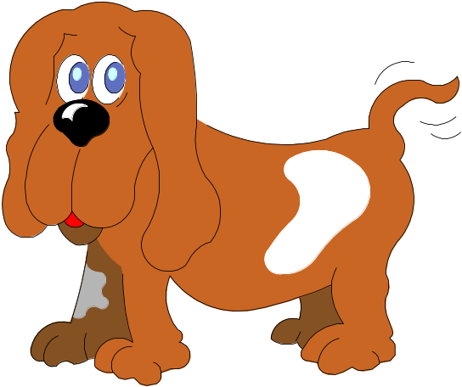
What are objects ?
Defined as a tangible(Possible to understand or realize) entity that exhibits some well-defined behavior :
Objects are real world entities
They contains attributes and operations
They represent a “State” (Att. Values )
  ex :
objects
e- Mail-message

Slide 6
Why are objects needed ?
It is easy to model real world objects
They hide the internal representation
They expose only required functionality
Generalized objects can help in reduced maintenance
  less dependent and reusable
  they have related functionality

Slide 7
How do objects interact ?
Message:
[sender, return value]
Sender object
Message:
[receiver, operation,
parameter]
Receiver object
Adv.: low coupling and highly reusable and easy maintainable

Slide 8


What is a class ?
Building block of object- oriented system
Class is a template for an object
Class specifies the object’s structures and operations
AnimalClass
Employee

Slide 9
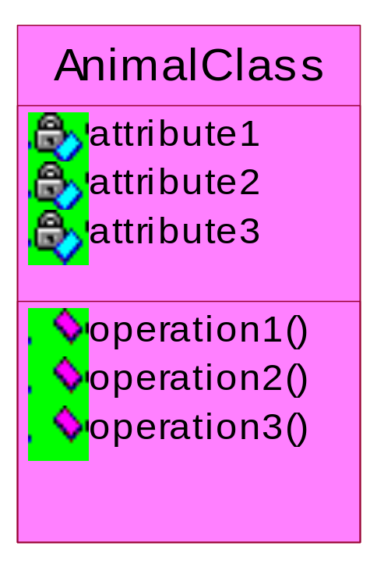
Class Representation
Car
No. of wheels
Color of car
Year of manufacture
Drive the car
Accelerate
Break

Slide 10
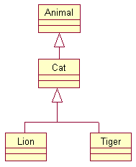
What are class hierarchies ?
Generalization of real world classes
lead to class hierarchy
Hierarchies can be expanded by further
specialization

Slide 11
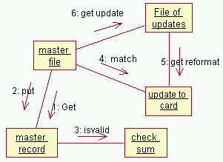
Process oriented v/s object oriented
Update file
Algorithmic Decomposition
Put
unmatched
master
Add checksum
Match
Update
Put
formatted
master
Get
formatted
update
Format
output
Object-Oriented Decomposition

Slide 12
OO Methods :
Booch ( OOD )
Rambaugh (OO Modeling & Design )
Coad & Yourdan ( OOA )
Embley ( OO system analysis )
Shlaor & Meller ( OO system analysis )
Wirfs - Brock (Designing OO Software )
Ivar Jacobson (OOSE) - Use Cases

Slide 13
Reuse : why?
Better Quality
Better maintenance - due to decoupled nature of the structure
High productivity
Consequently quick development
Easier to adopt and easily scalable

